Slide 1

Projects Using React.js & Flux
Project 4: MovieFind

Slide 2
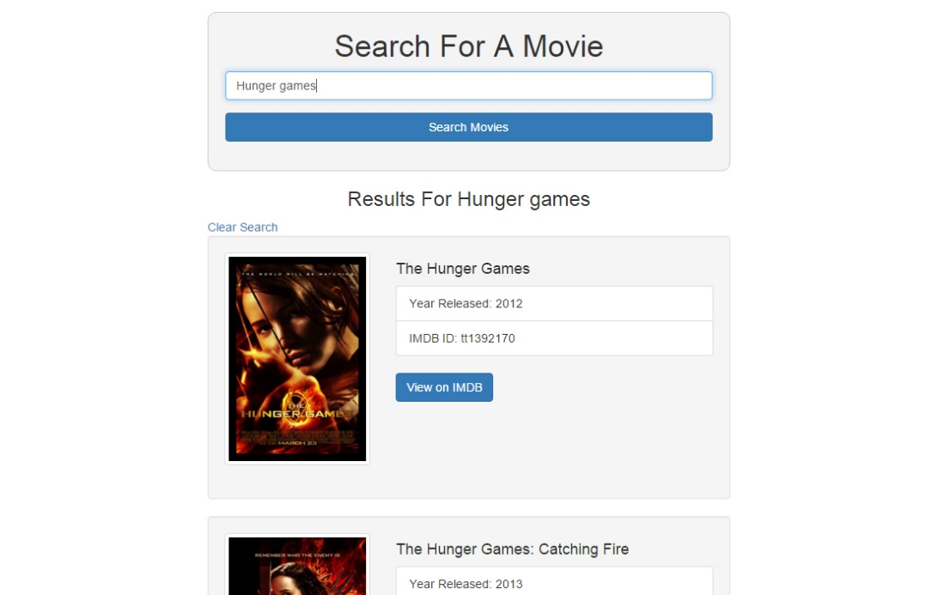
Project Description
An application that will let you search for movies in the IMDB database and show info and link

Slide 3
Project Lectures
Section Intro
Flux Structure & Gulp
Flux Setup & Preparation
SearchForm Component
Working With the API
Display Results

Slide 4
What You Will Learn
How to use Gulp tasks
How to compile JavaScript
How to work with the OMDB API
Work With JSON responses

